Slide 2
A Flash Cell

Slide 3
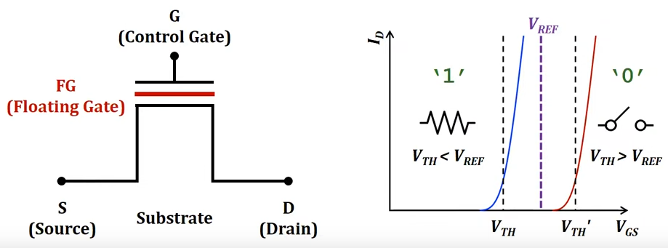
A Flash Cell
Basically, it is a transistor

Slide 4
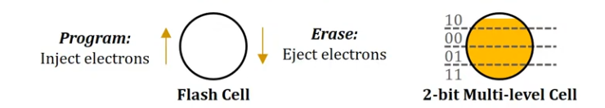
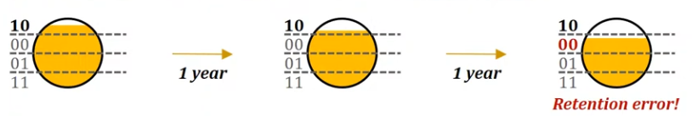
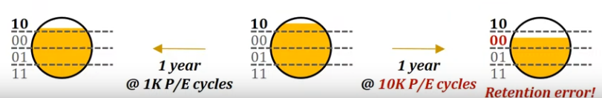
Flash Cell Characteristics
Multi-leveling
Retention loss
Limited lifetime

Slide 5
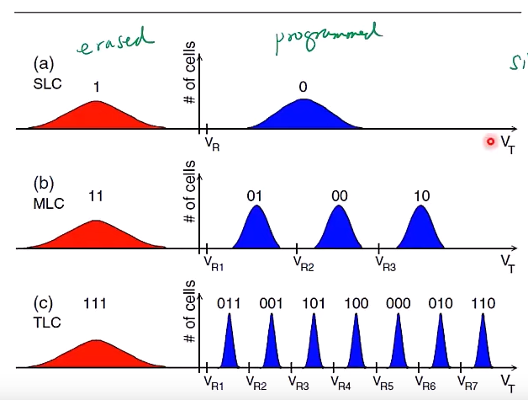
Flash Cell Characteristics

Slide 6
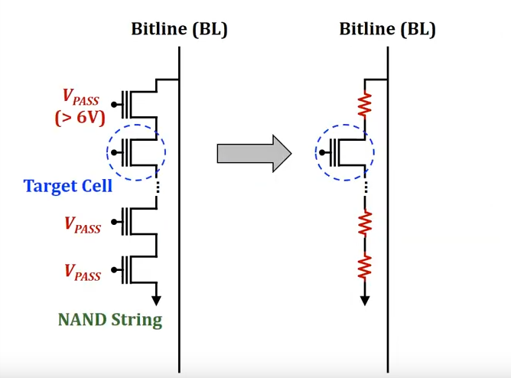
NAND String
Multiple flash cells are serial connected

Slide 7
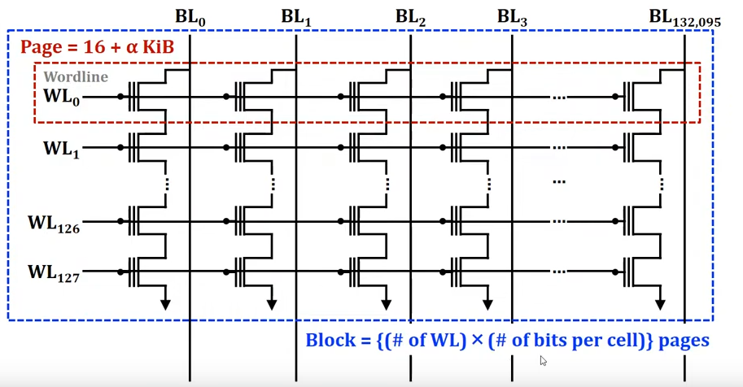
Pages and Blocks
A large number of cells operate concurrently
SLC: 1WL = 1 Page
MLC: 2WL = 2 Page

Slide 8
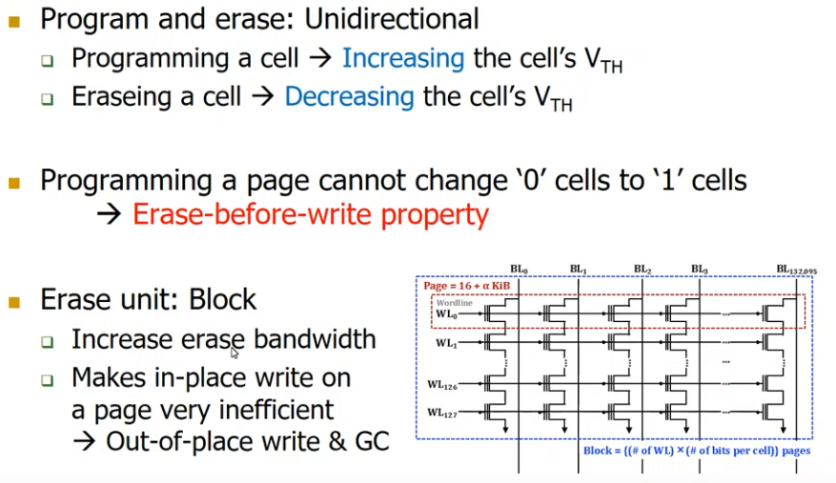
Pages and Blocks (Continued)

Slide 9
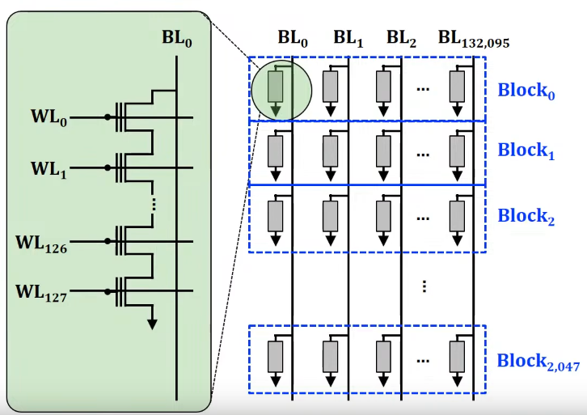
Planes

Slide 10
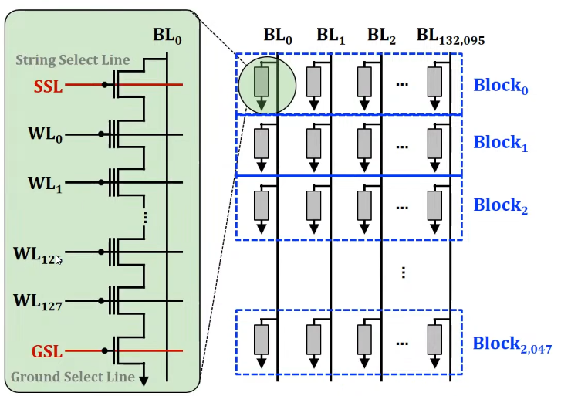

Slide 11
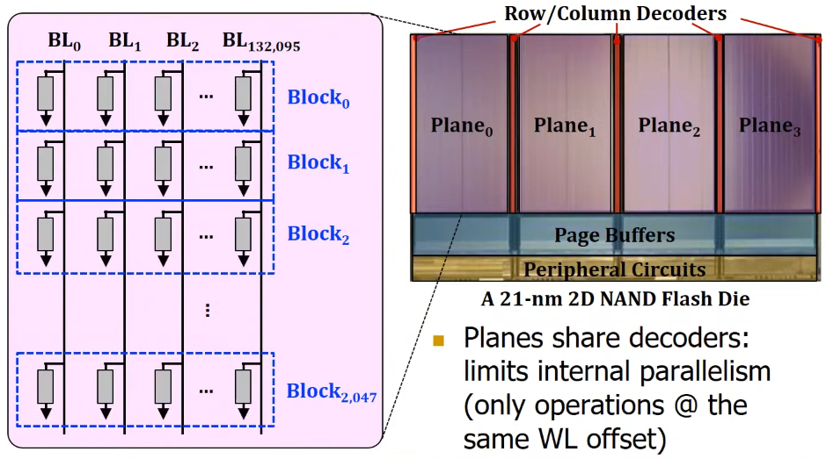
Planes and Dies

Slide 12
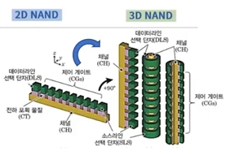
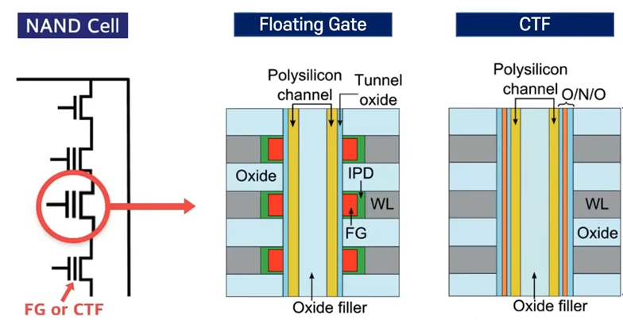
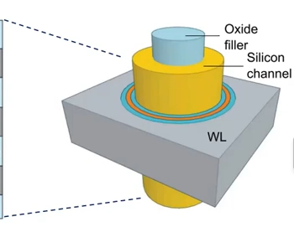
3D NAND

Slide 13
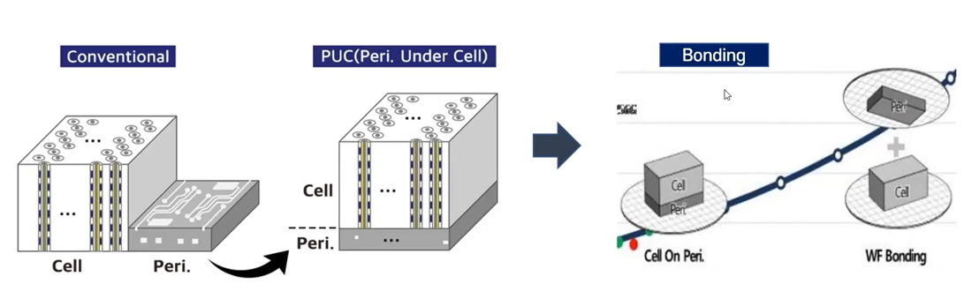
4D NAND Flash

Slide 14
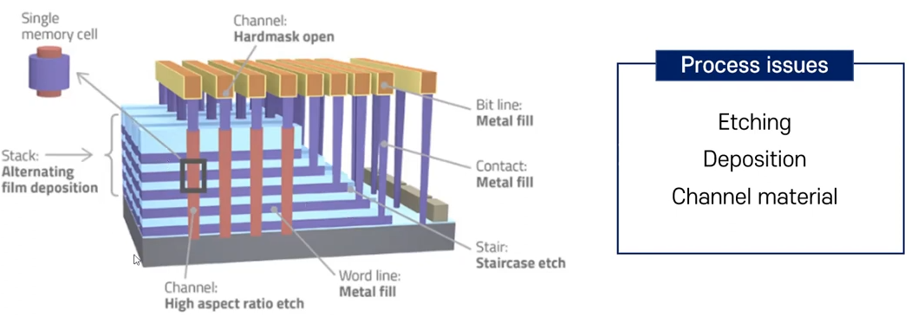
3D NAND Processing

Slide 15
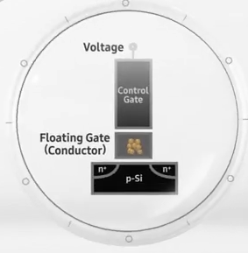
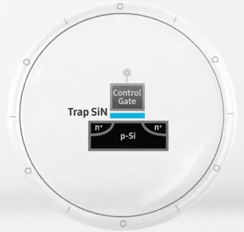
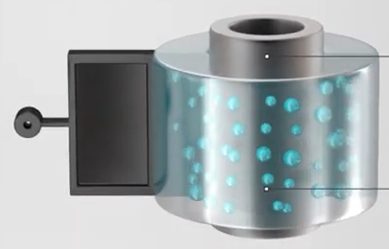
SAMSUNG V-NAND
FGF in 2006
CTF in 2006
3D CTF in 2013

Slide 16
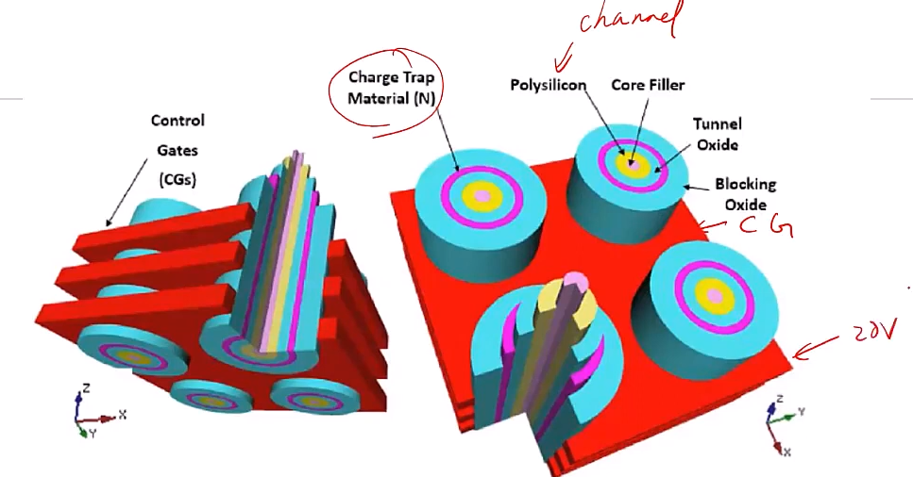

Slide 17
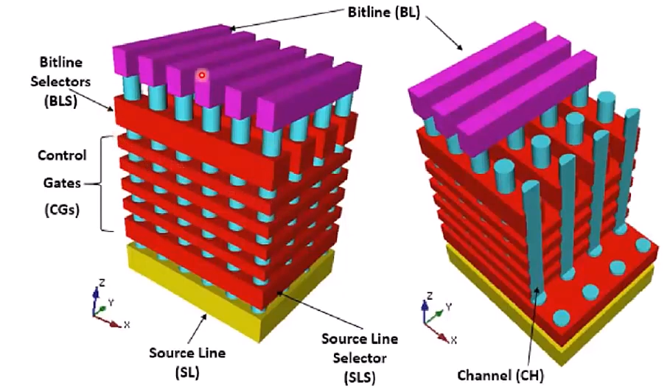

Slide 18
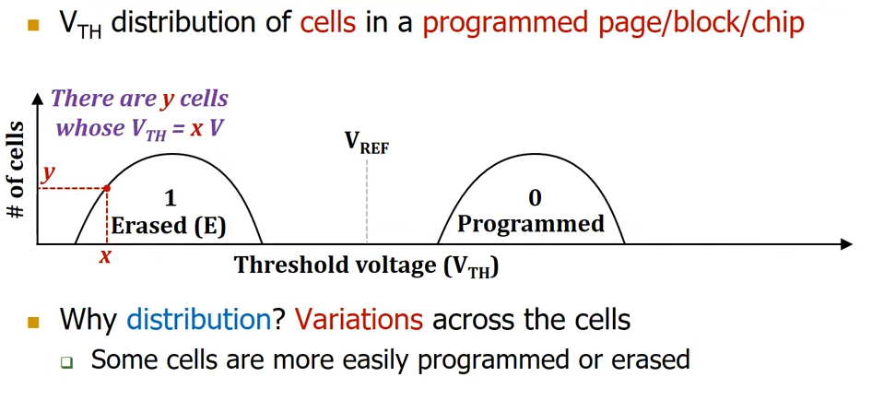
Threshold Voltage Distribution

Slide 19
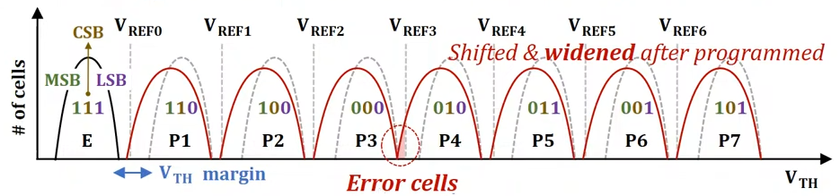
Distribution of TLC NAND Flash
Triple-level cell technique
2m Vth states required to store m bits in a single flash cell
Limited width of the Vth windows: Need to
Make each Vth state narrow
Guarantee sufficient margin b/w adjacent Vth states

Slide 20
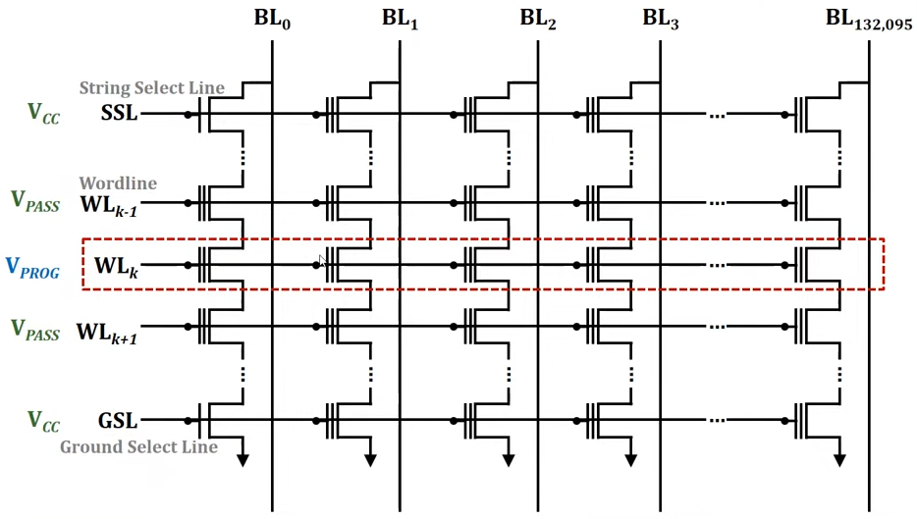
Page Program
WL control – All other cells operate as a resistance

Slide 21
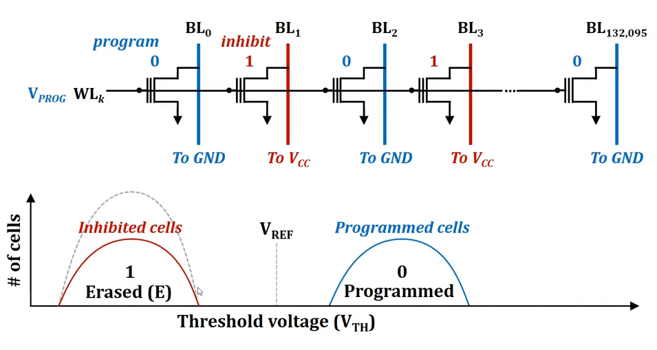
Page Program
BL control – Inhibits cells to not be programmed

Slide 22
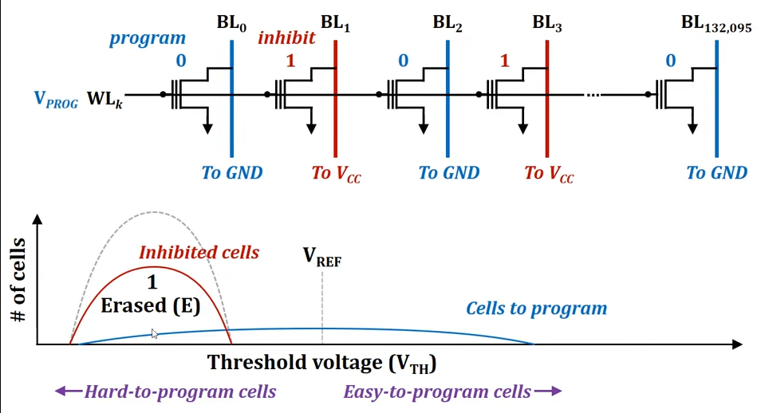
Page Program -Reality

Slide 23
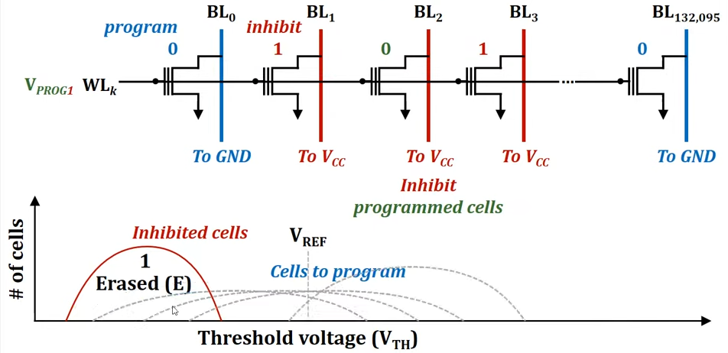
Page Program - ISPP
Incremental Step-Pulse Programming (ISPP)

Slide 24
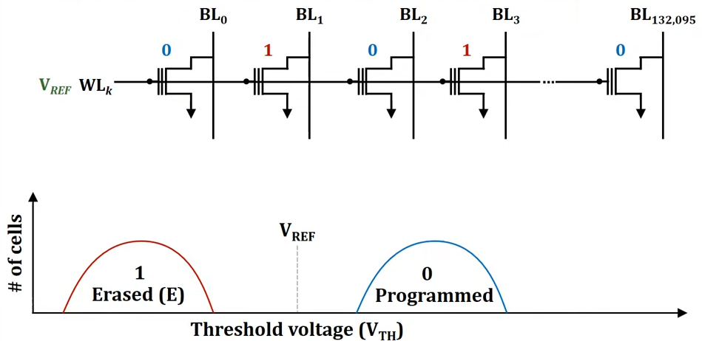
Page Read
WL control – All other cells operate as a resistance

Slide 25
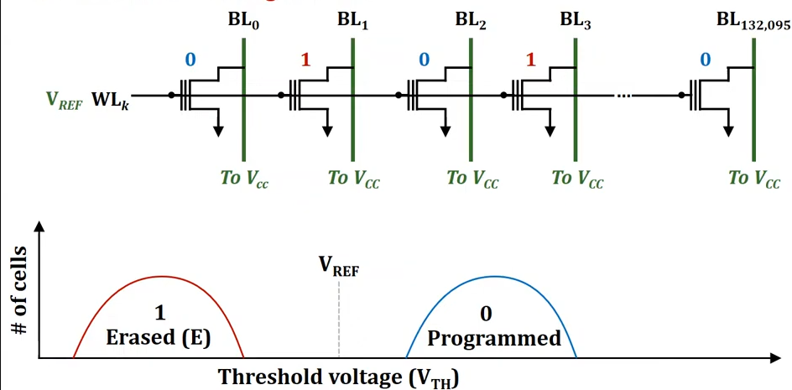
Page Read (Continued)
BL control – Charge all BLs

Slide 26
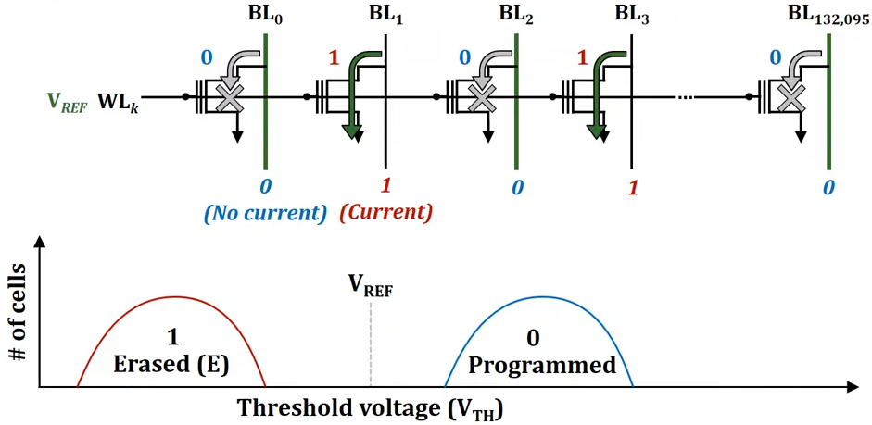
Page Read
Sensing the current through BLs

Slide 27
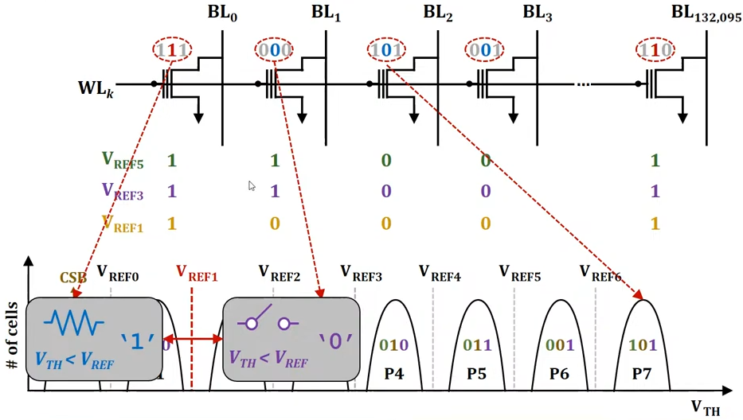
Read Page - TLC
Bit-encoding affects the read latency

Slide 28
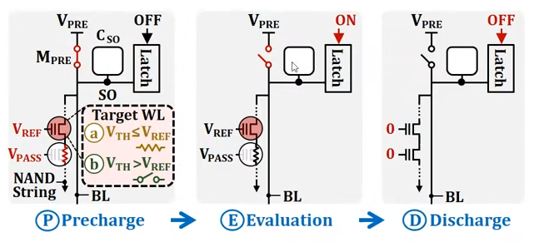
Read Mechanism
Sensing the current through BLs

Slide 29
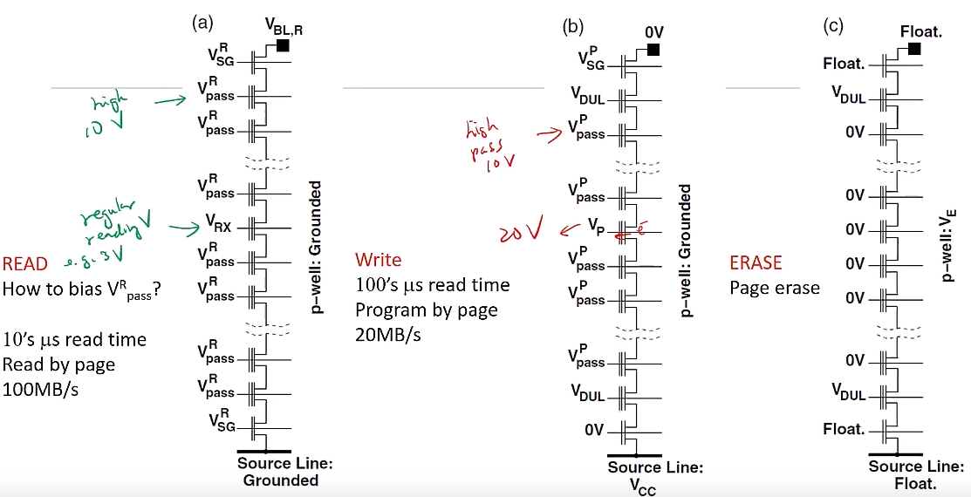
Page Write, Erase

